Slide 1

Workforce Intelligence &
Organizational Performance
A comprehensive analysis of departmental spend, revenue generation, operational health risks, and employee training efficiency across 30,000 workforce records.
Roblox Africa Operations | Ghana Hub
30,000 Employees
Roblox Africa Operations — Workforce Intelligence
Slide 1 of 10

Slide 2





Key Analytical Objectives
Primary Objective
Conduct an integrated workforce analysis enabling leadership to evaluate organizational performance, employee wellbeing, and cost efficiency across all operating departments.
01
02
03
04 & 05
Workforce Mix
Education Impact
Cost Efficiency
Health & Sustainability
Headcount, role mix, and gender balance across divisions.
Degree levels and field of study versus job placement.
Compensation patterns and revenue output distribution.
Operational wellbeing risks and long-term sustainability recommendations.
Roblox Africa Operations — Workforce Intelligence
Slide 2 of 10

Slide 3




Data & Methodology
Integrated Data Model
Seven previously siloed database tables were profiled, cleaned, and integrated into a unified star schema data model (`roblox_db`):
30K
8
Total Individual Employees
Operating Departments
Core Tables: Employee, Department, Education, Health, Finance
Performance Tables: EmployeePerformance, DepartmentPerformance
Granularity: Individual-level tracking with departmental aggregates
5 Yrs
150K+
Historical Window (2021–2025)
Total Records Integrated
Roblox Africa Operations — Workforce Intelligence
Slide 3 of 10

Slide 4



Objective 1: Workforce Composition
3.7K–3.8K
~50 / 50
6.4 Yrs
Balanced Headcount
Gender Ratio
Average Tenure
Headcount range across all 8 operating divisions.
Consistent gender split maintained in every department.
Uniform retention rates across the entire organization.
Key Insight: Workforce composition is remarkably evenly distributed across divisions—no single department shows a staffing bottleneck or gender imbalance requiring corrective restructuring.
Roblox Africa Operations — Workforce Intelligence
Slide 5 of 10

Slide 5

Objective 2: Education vs. Performance
< 1%
4.0 / 5
Flat
Salary Spread
Avg Performance
Credential Correlation
Negligible pay variance across different formal education levels.
Performance scores are virtually identical regardless of degree.
Zero correlation between field of study and job output.
Key Insight: Education level is not currently a meaningful predictor of pay or performance. The organization does not reward formal credentials with higher compensation, nor does advanced education yield higher output.
Roblox Africa Operations — Workforce Intelligence
Slide 6 of 10

Slide 6


Objective 3: Cost Efficiency
1.80x
1.46x
$8.7K–$8.8K
Human Resources
Product Management
Average Salary
Highest revenue-per-cost efficiency ratio across departments.
Weakest revenue-per-cost efficiency ratio.
Salary cost remains virtually uniform company-wide.
Key Insight: Salary expenditure is flat, but revenue output per dollar spent varies significantly. The efficiency gap is purely operational—driven by business unit output rather than compensation disparities.
Roblox Africa Operations — Workforce Intelligence
Slide 7 of 10

Slide 7

Objective 4: Health & Wellbeing Risk
~33%
~49%
15 Days
Expired Insurance
Leave Ineligible
Avg Leave Balance
One-third of employees hold expired insurance policies.
Half of workforce is currently ineligible for formal leave.
Average medical leave balance remaining per employee.
Key Insight: Operational health risk is systemic rather than localized. It impacts roughly 33% to 49% of the workforce equally in every department, pointing to a company-wide policy or renewal-process gap.
Roblox Africa Operations — Workforce Intelligence
Slide 8 of 10

Slide 8
Training Investment vs. Output
r ≈ 0.23
r ≈ 0.11
r ≈ 0.24
Vs. Performance
Vs. Revenue Output
Vs. Total Cost
Weak correlation between completed training hours and performance scores.
Negligible link between training hours and top-line revenue output.
Training hours track operational cost higher than performance gain.
Key Insight: Training hours track operational expense more closely than they drive performance or revenue output. This highlights a clear training ROI gap that requires curriculum re-alignment.
Roblox Africa Operations — Workforce Intelligence
Slide 9 of 10

Slide 9

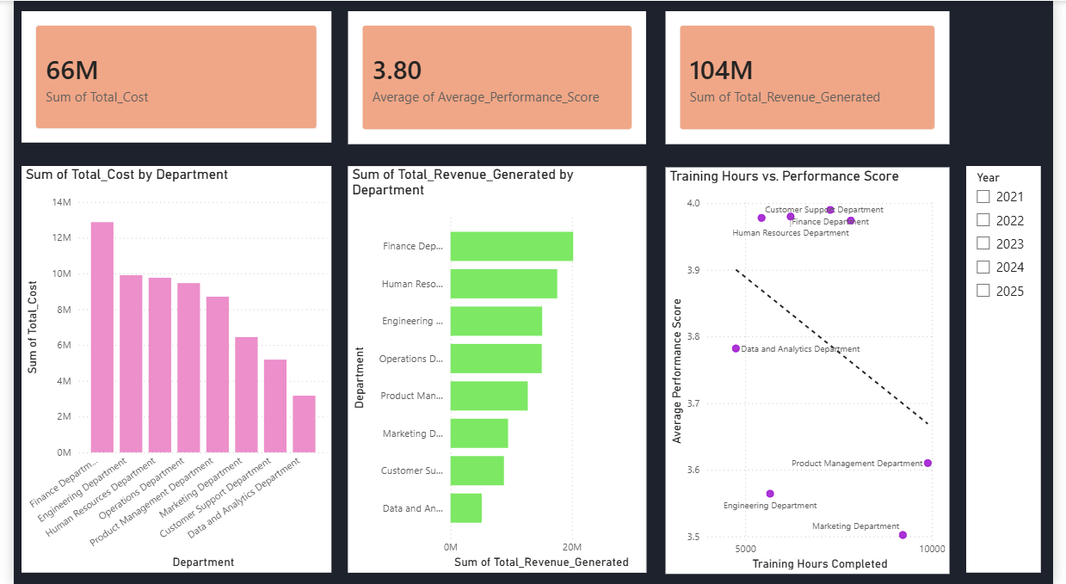

Live Dashboard Snapshot
PASTE POWER BI DASHBOARD SCREENSHOT HERE
Interactive view — Filterable by Department and Year in the Power BI Canvas
Roblox Africa Operations — Workforce Intelligence
Slide 4 of 10

Slide 10




Recommendations
Recommendations
Actionable Recommendations
Q2 - L&D Reform
Q4 - Review & Scale
Redesign training curriculum to focus on targeted skill uplift rather than raw logged hours.
Measure post-intervention performance scores and track insurance compliance to 100%.
Investigate Cost Efficiency: Audit Product Mgmt & Marketing cost structures (lowest rev/cost at 1.46x–1.47x).
Reassess Training ROI: Shift from mandatory blanket hours to targeted competency micro-learning.
Remediate Wellbeing Risk: Deploy automated portal alerts to fix the 33% expired insurance deficit.
Q1 - Policy Audit
Q3 - Budget Realignment
Revisit Compensation Strategy: Base pay on demonstrated role-based skills rather than formal degrees.
Conduct full insurance renewal sweep and resolve expired policies across top departments.
Reallocate operational expenditure toward high-performing, high-margin revenue units.
Roblox Africa Operations — Workforce Intelligence
Slide 10 of 10

Slide 11
THANK YOU

